Slide 1
MIPS Pipeline Simulator
Josh Boubel
CS3339
Spring 2026

Slide 2
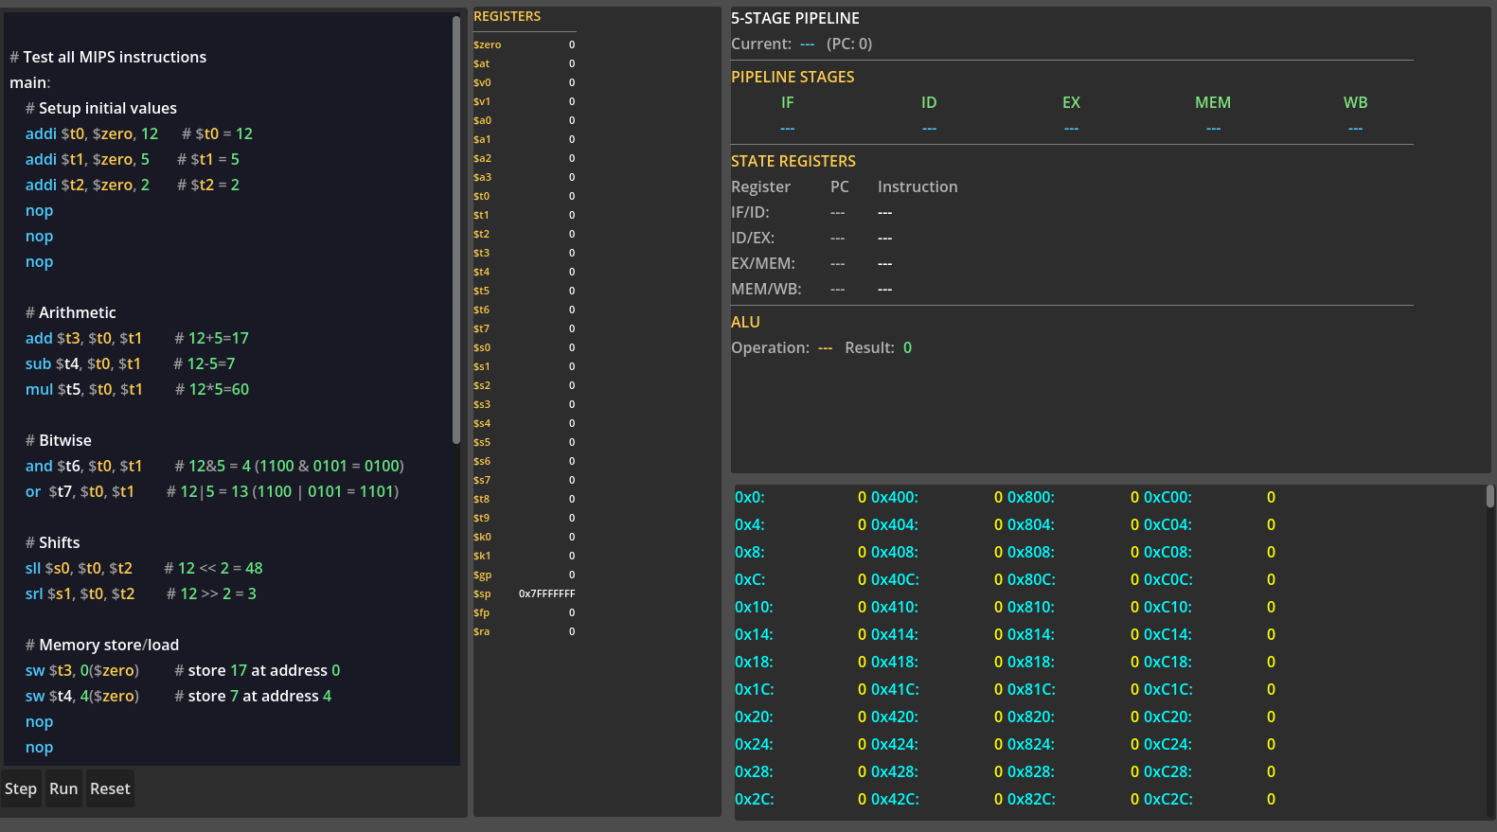
Overview
Functions
Outputs
Simulate 5 stage pipelined MIPS CPU
Process MIPS instructions including ADD, ADDI, SUB, MUL, AND, OR, SLL, SRL, LW, SW, BEQ, J, NOP
Built-in assembly Editor
Single clock cycle step, continuous run, and program reset controls
Contents of register file and data memory
Pipeline stages and state registers
ALU operation and result

Slide 3
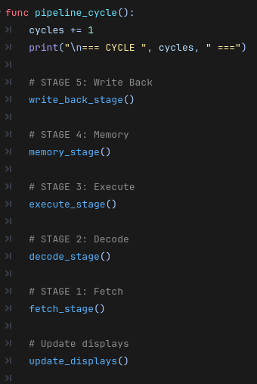
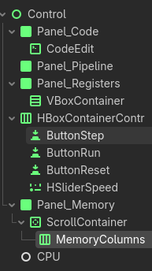
Architecture
Each stage is a small processing element that does a specific job and passes its output to the next stage via a state register once per clock cycle
Built on Godot 4.6.2
Scene setup
Assembly Editor
Pipeline and state registers display
Register file display
Control buttons
Data Memory Display
Core simulation logic

Slide 4
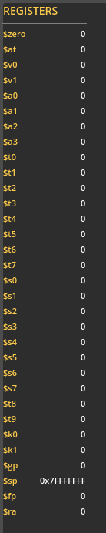
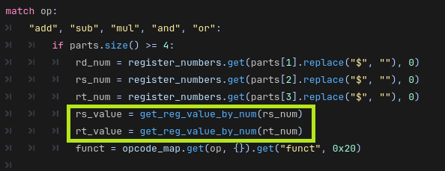
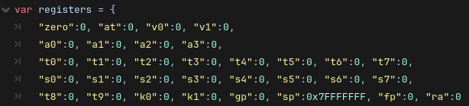
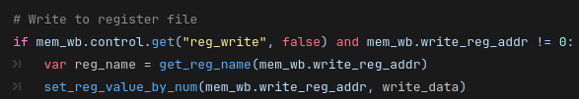
Register File
Registers are read in the decode stage
The register file is written back to in the last stage of the pipeline WB
In this program the register file is implemented as dictionary

Slide 5
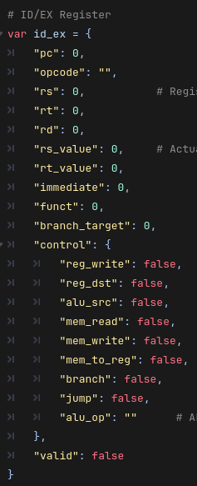
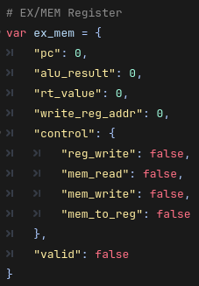
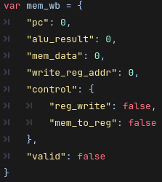
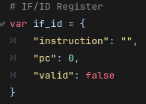
State Register Implementation
Each holds program counter, instruction data, control signals, and other data to be used by the next stage allowing multiple instructions to pass through the data path simultaneously.
Each pipeline stage requires different signals and data to function properly
IF
IF/ID
ID
ID/EX
EX
EX/MEM
MEM
MEM/WB
WB

Slide 6

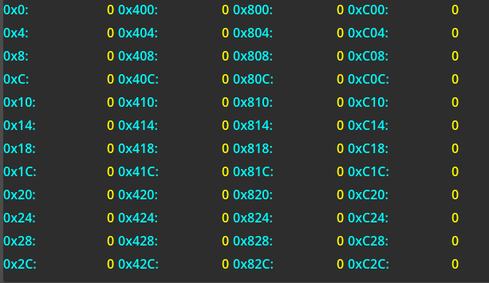
Data Memory
Stored in an array in the CPU script
Accessed when lw or sw instruction passes through the mem stage
4096 bytes available
Addresses increment by 4 to match word size

Slide 7
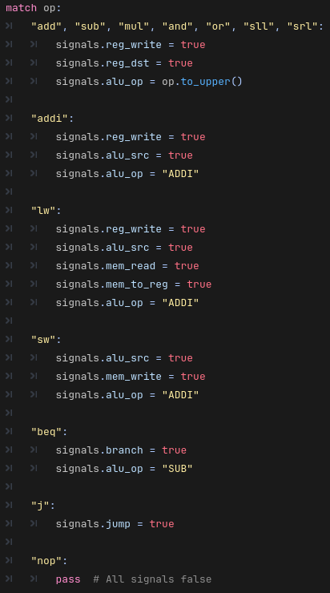
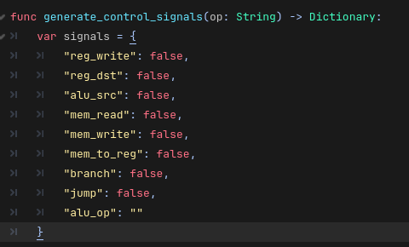
Control Unit
The generate_control_signals function acts as the control unit and is called by the ID stage
The opcode is pulled from the instruction(as a string in this case) for the control unit to determine what signals are needed to execute the instruction

Slide 8
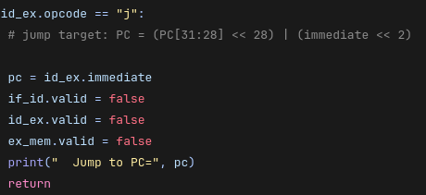
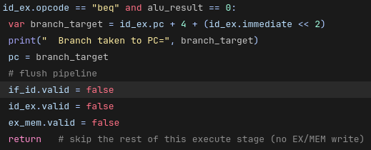
Pipeline flushing for J types
Because j type instructions don’t execute until the ex stage, instructions intended to be skipped can enter the pipeline
By invalidating the state registers, the instructions can be stopped from flowing through the pipeline, preventing them from being executed when they should be skipped

Slide 9
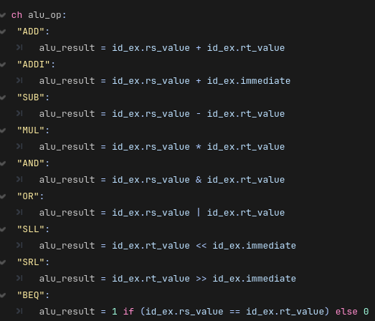
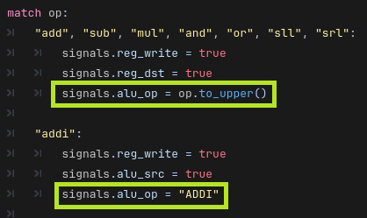
ALU Control
The opcode extracted in the ID stage is passed on to the ID/EX state register where it can be used by the ALU in the execution
With this in the state register the ALU can determine which function needs to be performed

